Slide 1
Model Free methods
Module 4

Slide 2
We have learnt to solve reinforcement learning problems using Dynamic Programming (DP) through:
Policy Iteration
Value Iteration
These methods require complete knowledge of the environment, i.e. we are required to know the model of the environment, i.e, p(s′,r|s,a).
However, in most real-world scenarios, the model is not available. We have to implicitly infer the model from the observations. Methods designed to solve these scenarios are called model-free methods. Examples of such model-free environments are self-driving space, games such as Go, etc.

Slide 3
Monte-Carlo method
-maximize reward given the environment is stochastic.
-Expected rewards
Monte-Carlo method is based on the concept of the law of large numbers.
The law of large numbers says that if you take a very large sample, it will give similar results as to what you would get if you would have known the actual distribution of the samples.
The expected value of a random variable is the weighted average over the probabilistic distribution values. It can also be thought of as the average (or mean) of a (~infinitely) large enough sample drawn from the same distribution.

Slide 4
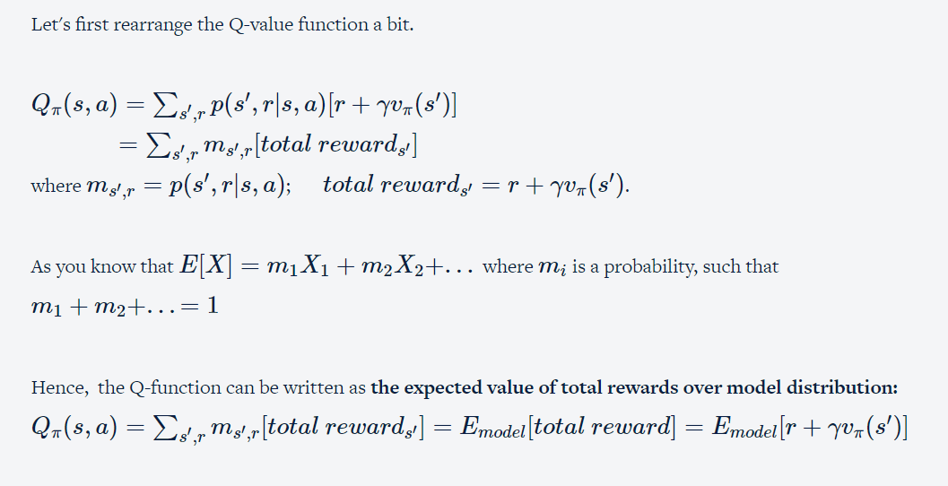

Slide 5
Say, you run the episodes an infinite number of times and calculate the rewards [r+γvπ(s′)] earned every time a (state, action) pair is visited. Then take the average of these values. The average value will give you an estimate of the actual expected state-action value for that (state, action) pair.
The Monte-Carlo methods require only knowledge base (history/past experiences)—sample sequences of (states, actions and rewards) from the interaction with the environment, and no actual model of the environment.

Slide 6
Prediction and control are two integral steps to solve any Reinforcement learning problem.
Prediction - evaluating the value function/policy
Control - improving the policy basis the state-value function estimates

Slide 7
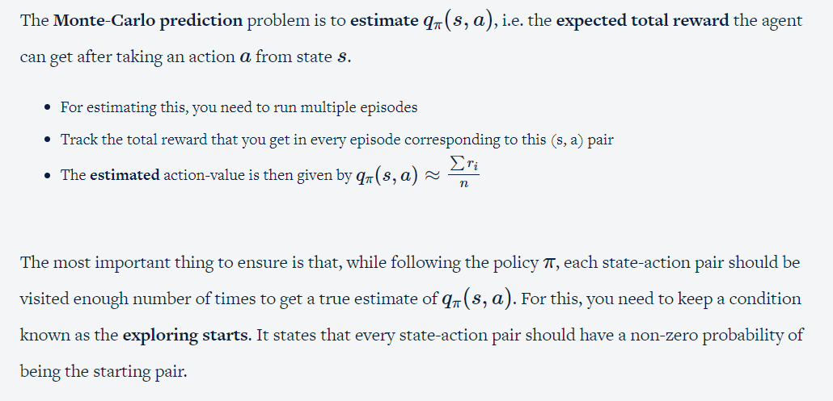
Monte Carlo Prediction:

Slide 8
Why is 'exploring starts' required?
To get an estimate of the state (s, a), we run multiple episodes starting from the same state-action pair (s, a), so we’ll need to start multiple episodes from (s, a), but what we need to ensure is that once the agent reaches s', it takes all possible actions from s' in various episodes (and not just take the ones that are more probable according to the current policy). Because if that happens, then all the ri (the total rewards in various episodes) will basically be the same.

Slide 9
Let's assume that there are a total of 10 states (S1, S2, ..., S10) in the environment and 10 actions (A1, A2,.., A10) that can be taken from each of these states. The Monte-Carlo prediction problem is to find an unbiased estimate of qπ(s,a) for each state-action pair for a deterministic policy π.Assume γ=1 and initialised q(s,a)=0.
An episode can be started with any of the 10 states that you have."exploring starts" allows you to perform any random action in this initial state. However, from the next state onwards, it follows π. So, the subsequent states will have a fixed action corresponding to each state. The new_state s' and the immediate reward r can be different even when you perform the same action a in state s, because the environment is stochastic.
Episodes are tracked as (state, action, immediate reward) series.

Slide 10
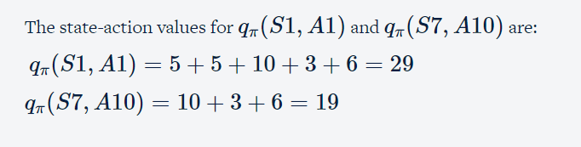
Episode 1: (S1, A1, 5), (S5, A3, 5), (S7, A10, 10), (S4, A5, 3), (S10, A5, 6)
Episode 2: (S3, A2, 7), (S1, A1, 5), (S7, A9, 6),(S4, A5, 4), (S6, A10,3)
Episode 3: (S2, A3, 6), (S1, A1, 5), (S2, A3, 3),(S1, A1, 2), (S7, A9, 4)

Slide 11
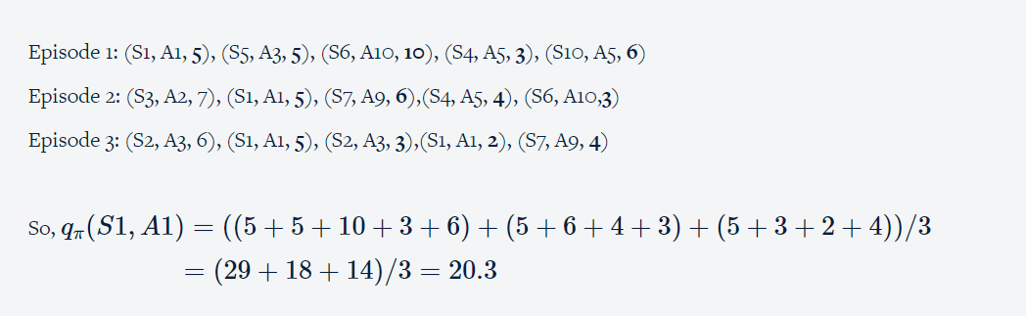
In the third episode, (S1, A1) is visited twice. Typically, there are two ways to calculate total rewards.
First visit: You can compute the total rewards when (S1, A1) is visited the first time. So, the total rewards earned in episode 3 for (s1, A1) pair is 5+3+2+4=14
Every visit: You can compute the total rewards whenever (S1, A1) is visited. So, the total rewards earned in episode 3 for (s1, A1) pair = (5+3+2+4) + (2+4)=20

Slide 12
Similarly, we can calculate the qπ(s,a) for other state-action pairs, over a large number of episodes. For that, all state-action pairs have to be visited enough number of times to get a true estimate.

Slide 13
Monte Carlo Control
Control problem is to improve the existing policy in order to find an optimal policy.
Policy improvement is done by constructing an improved policy π′ as the ϵ-greedy maximisation with respect to qπ(s,a).

Slide 14
Epsilon-greedy
Epsilon-greedy is a popular algorithm used in reinforcement learning for balancing the exploration and exploitation trade-off. The algorithm follows a simple strategy of choosing the best action with probability (1-epsilon) and choosing a random action with probability epsilon.So, ϵ is a hyperparameter that controls the tradeoff between exploration and exploitation.
If ϵ is too small, then actions are biased to be more greedy
If ϵ is too large, then actions explore more.

Slide 15
Epsilon-greedy maximization is a commonly used strategy in policy improvement for reinforcement learning. It is a way to balance exploration and exploitation when selecting actions for an agent to take in a given state.
In epsilon-greedy maximization, the agent selects the action that maximizes the expected cumulative reward with a probability of 1-epsilon, and with probability epsilon, the agent selects a random action from the action space. The value of epsilon is typically set to a small value (e.g., 0.1) to ensure that the agent continues to explore new actions while still favoring actions that are known to produce high rewards.
The purpose of using epsilon-greedy maximization is to ensure that the agent does not get stuck in a suboptimal policy due to early convergence or insufficient exploration. By allowing the agent to explore new actions with a small probability, epsilon-greedy maximization encourages the agent to try different actions and learn about the environment, while still exploiting the actions that have already been learned to be optimal.

Slide 16
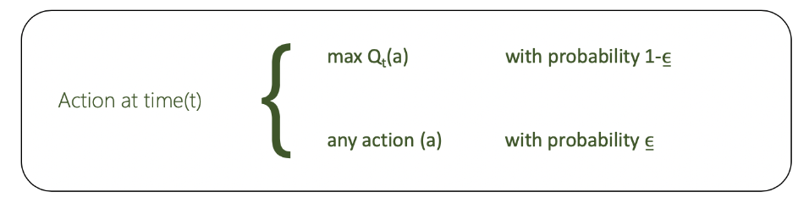
The epsilon-greedy, where epsilon refers to the probability of choosing to explore, exploits most of the time with a small chance of exploring.

Slide 17
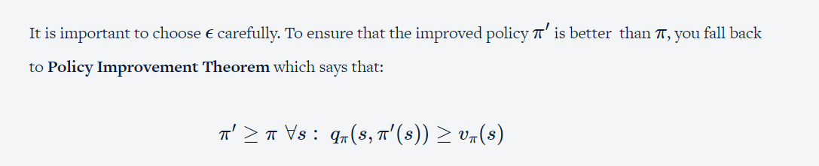

Slide 18
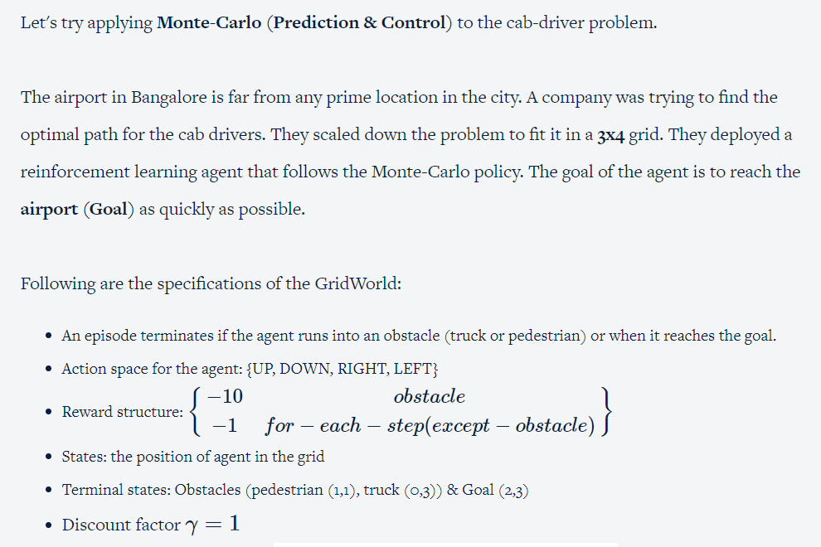

Slide 19
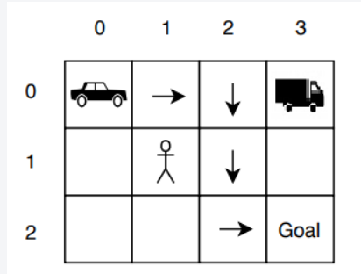
What is the value of q(s=(0,0), a=RIGHT) after Episode 1?

Slide 20
Off Policy
Control problem seeks the best action values for the agent to behave optimally.
However, the agent has to behave non-optimally in order to explore other actions (i.e. the actions that are not given by the policy), to find better action than already existing one.
A way to handle the dilemma of exploring and exploitation is by using two policies:
Target Policy: the policy that is learnt by the agent and that becomes the optimal policy
Behaviour Policy: the policy that is used to generate the episodes and is more exploratory in nature
This is called off-policy because the agent is learning from data 'off' the behavior policy.

Slide 21
Off-policy learning is a type of reinforcement learning in which the agent learns from data that was generated by a different policy than the one being currently evaluated. In other words, the agent learns from experience that it did not directly obtain by interacting with the environment using its current policy.
Importance sampling is a technique that is used to ensure that the state-actions pairs produced by the target policy are also explored by behaviour policy.

